Slide 1

Introducing STENO: A Secure Steganography Tool
STENO is a user-friendly steganography tool designed for secure data hiding across multiple file formats. It offers robust techniques to minimise detectability and enhance security. This presentation will explore STENO's features, development process, and advantages.
Notes:
1

Slide 2
Existing Systems & Challenges
Limitations
The Need
Limited format support
A comprehensive, user-friendly, and secure steganography solution is needed to overcome the shortcomings of existing tools.
Complex interfaces
Weak security
Notes:
2

Slide 3

STENO's Objectives
User-Friendly Interface
Robust Steganography
Intuitive design for all steganography operations.
Minimizes detectability using advanced techniques.
Enhanced Security
Cross-Platform Compatibility
Password protection and potential encryption for data safety.
Wide accessibility across different operating systems.
Notes:
3

Slide 4

Problem Definition & Software Development
1
Problem
Creating a secure, multi-format steganography tool accessible to all users.
2
Agile Development (Scrum)
Iterative development using Scrum for flexibility and efficient progress.
3
Benefits
Improved collaboration, faster adaptation to changes, and higher quality software.
Notes:
4

Slide 5
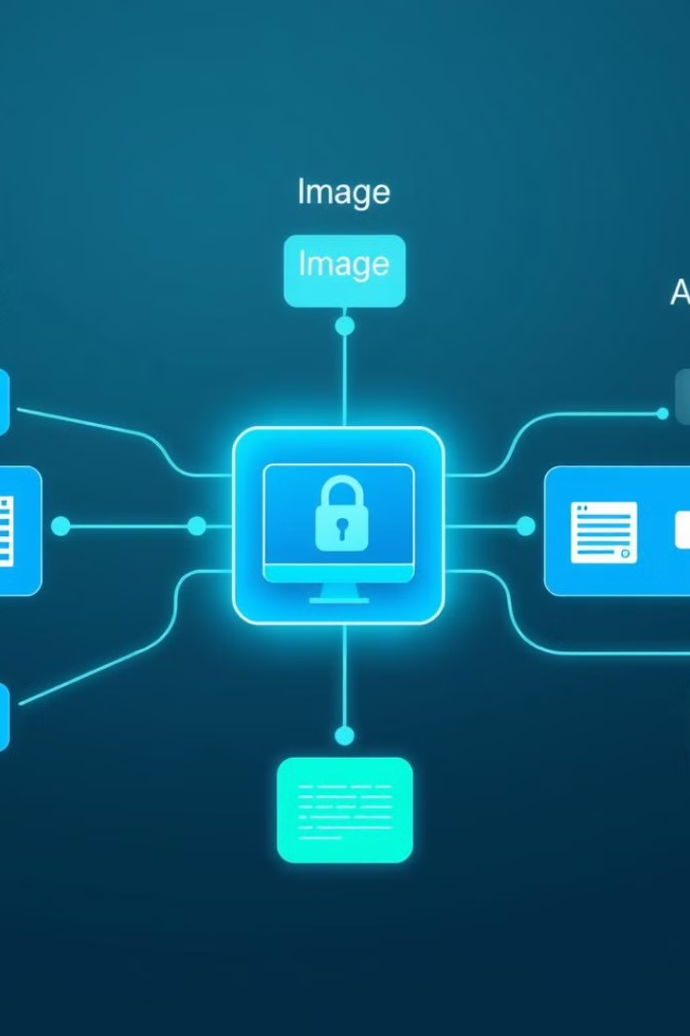




Core Components of STENO
Text Steganography
Image Steganography
SNOW algorithm for text files.
LSB technique for image files.
Audio Steganography
Database & GUI
LSB technique for WAV files.
SQLite for user accounts, Tkinter for cross-platform GUI.
Notes:
5

Slide 6
Project Profile: STENO
Project Name
Version
Language
STENO
1.0
Python
Libraries
Database
Version Control
Tkinter, OpenCV, Wave
SQLite
Git
Repository
https://github.com/enough-jainil/Steno-project.git
Notes:
6

Slide 7
Advantages & Limitations of STENO
Advantages
Limitations
Multi-format support (text, image, audio)
Currently lacks video support
User-friendly interface
Can be time-consuming for large files
Cross-platform compatibility
Limited customization options for advanced users
Enhanced security features
Extensible architecture for future improvements
Notes:
7

Slide 8
Requirement Determination & Analysis
Functional Requirements
1
Detailed system capabilities for text, image, and audio steganography, user interface features, and security aspects.
Non-Functional Requirements
2
Usability, performance, reliability, scalability, compatibility, and maintainability are key considerations.
Notes:
8

Slide 9
Hardware Requirements for STENO
2GB
4GB
Minimum RAM
Recommended RAM
1GHz
2GHz
Minimum CPU
Recommended CPU
10GB
50GB
Minimum Storage
Recommended Storage
These specifications ensure optimal performance and compatibility for STENO across various systems. Higher specifications are recommended for larger files or more demanding operations.
Notes:
9

Slide 10





System Design of STENO
Use Case Diagram
1
User-system interactions.
2
Class Diagram
Class structure and relationships.
3
Sequence Diagram
Message order between objects.
4
Activity Diagram
Flow of activities.
5
Data Dictionary & Algorithm Flow
Data structures and algorithm details.
These diagrams provide a comprehensive overview of STENO's architecture, ensuring clarity and facilitating further development and maintenance.
Notes:
10

Slide 11
Development & Implementation
Coding Standards
User Interface Elements
Key Features
Python code adheres to PEP 8 guidelines, ensuring consistency and readability.
STENO offers multi-format support, password protection, cross-platform compatibility, real-time feedback, and format-specific interfaces for user convenience.
STENO features a main dashboard with intuitive file selection, operation controls, and status indicators.
Notes:
11

Slide 12
Testing & Quality Assurance
Unit Testing
Integration Testing
Quality Metrics
Individual components are tested in isolation, focusing on functional correctness and error handling.
Modules are combined to verify system interactions and workflows. Cross-platform compatibility is checked.
Code coverage, performance benchmarks, security assessments, and user experience testing are conducted to ensure STENO meets quality standards.
Notes:
12

Slide 13
Future Enhancements
Video Steganography
Machine Learning Integration
STENO will expand to support video file formats. This enables concealing sensitive information within video files.
STENO can leverage machine learning for automatic steganography, identifying the best embedding methods for different file types.
Cloud Storage Support
Mobile Applications
STENO will integrate with cloud storage platforms, providing secure and convenient file storage and sharing options.
STENO will become accessible on mobile devices, making it more portable and convenient for users.
Notes:
13

Slide 14
Impact & Applications
Secure Communication
Data Protection
STENO enables confidential communication, ensuring the secrecy of sensitive information exchanged between parties.
Protecting sensitive data from unauthorized access and modification is crucial, STENO provides a robust steganographic solution.
Educational Purposes
Industry Benefits
STENO can be used in classrooms to demonstrate the principles of cryptography and data security.
Industries can leverage STENO for corporate security, privacy protection, information security, and research applications.
Notes:
14

Slide 15
Conclusion: STENO - A Secure Steganography Tool
Achievements
Project Outcomes
Future Scope
STENO has successfully achieved its goals by implementing a secure and efficient steganography tool. The project has delivered on its promises of enhanced security features, user-friendly interface, and cross-platform support.
The project has successfully demonstrated technical proficiency in steganography, security implementation, and modern UI/UX design. STENO's extensible architecture allows for future expansion and growth.
STENO has a promising future with potential for expanding to support additional file formats, implementing advanced features, expanding to new platforms, and fostering a vibrant community of users.
Notes:
15

